Slide 1
Buffer(Queue) Management:
Buffer(Queue):
Buffer is a region of memory used to temporarily hold data while transmitting
data packets from one device to another or one network to another.
Dynamic Buffer Management:
Dynamic Buffer Management adjusts the buffer size based on network conditions
And it optimizes the performance varying network load.
Buffer Overflow:
Buffer Overflow occurs when more data is sent to a buffer than it can handle,
Leading to data loss or corruption.
Buffer Underflow:
Buffer Underflow occurs when there is not enough data in the buffer, leading to
a delay in data transfer.

Slide 2
Advantages:
1.Regulating dataflow between the devices and networks.
2.Allowing the sender to transmit data at a faster rate.
3.Preventing lost data due to network congestion.
Disadvantages:
1.Increased latency due to time it takes to store and retrieve data from the
buffer.
2.Increased memory usage due to the buffers storage requirements.

Slide 3
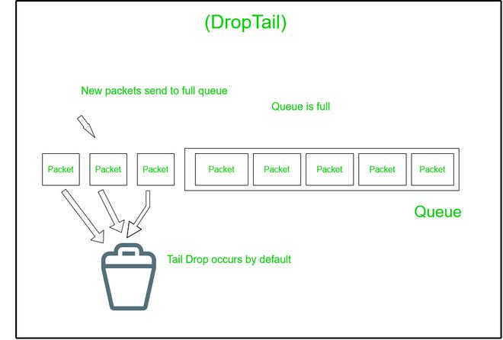
1.Passive Buffer(Queue) Management:
Passive Queue Management algorithms are reactive in nature i.e., they
operate ‘after’ the queue is full. They are easy to deploy. Example: FIFO
Passive Buffer(Queue) Management is divided in to 3 types they are:
1.Drop tail 2. Drop Head(Drop Front) 3. Random Drop
1.Drop tail: It drops the packets from the ‘tail’ of the queue. When the queue gets full and packets are still arriving, the incoming packets get dropped because there is no space in the queue. Since the packets are getting dropped from the tail, it is called Drop Tail. It acts like a simple FIFO queue. The packets which have arrived first are queued and packets coming later are getting dropped.

Slide 4
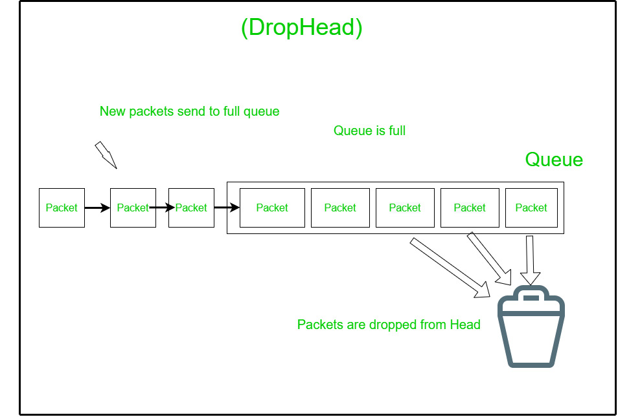
2. Drop Head(Drop Front):
It drops the packets from the ‘head’ of the queue. When the queue gets full but packets are still coming, then it makes the space for newly coming packets by dropping the packets from the head of the queue. This is also called Drop Front.
Drop Head ensures fairness. The long-lasting flows like bit-torrent consume the majority of the bandwidth and other applications become slower. The packets of long-lasting application will keep filling the buffer and short-lasting flows will get dropped by Drop Tail, but Drop Head will make space for them by dropping the packets of long-lasting flows. It does justice with the short-lasting flows.

Slide 5
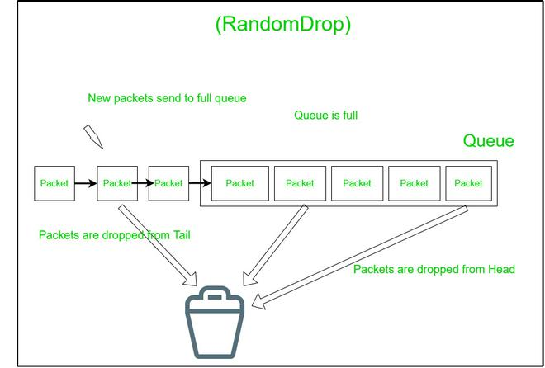
3. Random Drop:
As the name suggests, it drops the packets from a random ‘position’ in the queue.
A random number is generated and the packet at that index is dropped.
This gives a fair chance to every packet to stay in the queue.
Question: What is the advantage of using Random Drop? If we drop the packets from the head, then we are hurting the long-lasting flows. If we drop the packets from the tail, we are hurting the time-sensitive flows. So, to be fair with both types of flows, we randomly select one packet and drop it.

Slide 6
Drawbacks of Passive Buffer(Queue) Management:
It does not control congestion. If Packet drop occurs, it can’t control the packet drops. Three major drawbacks are listed below.
1.Global Synchronization 2. Lock Out 3. Buffer bloat
1. Global Synchronization:
Suppose multiple TCP flows start at different times, say time=0, time=5, and time=15 seconds.
All these flows start with a slow start algorithm to handle the congestion.
The congestion window of all TCP connections increases by slow start.
Drop Tail causes many packets of all the flows to be dropped at the same time. Drop Tail treats all flows equally, it does not give priority to any flow.
When Drop Tail drops the packets of each flow, then TCP flows to reduce their congestion window at the same time, this is the first time all flows are synchronized. Subsequently, all TCP flows increase their congestion window at the same time (synchronized).
When all flows reduce their cwnd by half at the same time, they are not utilizing the bandwidth fully, so it’s underutilization of the bandwidth.
Similarly, when all flows increase their cwnd, overutilization happens. Frequent periods of link ‘overutilization’ and ‘underutilization’. This adds jitter (variation in delay).

Slide 7
2. Lock Out:
Drop Tail allows a few flows to monopolize the queue space. These flows are typically long-lasting flows (‘elephant’ flows). Short flows (mice flows) do not get sufficient space in the queue due to the large occupancy of long-lasting flows. Packets of short flows get dropped. This phenomenon is called ‘Lock Out’. Note that Drop Head is the solution to this problem but not 100%. Drop Head drops the packets from the head of the queue and allows one packet of short flows to enter at a time. But how much space this Drop Head is making? Very less compare to the size of the queue. Still, the majority of the space is held up by the long-lasting flows. Since short flows are not getting space in the queue, their packets will constantly get dropped and this is called a lockout.
3. Buffer bloat:
Memory prices have fallen sharply. This problem existed earlier also but never became serious because of the memory size and price. In 2005, the maximum RAM capacity was 256 MB, but today it is 8 GB minimum. Hence, buffering capacity has increased. Excessive buffering leads to ‘high queuing delays. It was reported that queuing delays sometimes rise so much that TCP RTO expires! Time-sensitive applications are the worst affected ones due to buffer bloat.

Slide 8
2.Active Queue Management:
Random Early Detection (RED) Algorithm:
RED is among the first Active Queue Management (AQM) algorithms. RED was proposed
in 1993 by Sally Floyd. RED is called by three different names Random Early Discard or Random Early Drop or Random Early Detection.
Avoid congestion: Passive Queue Management suffers from this problem. AQM detects the congestion beforehand and avoids it.
Avoid the problem of global synchronization: Passive Queue Management suffers from this problem. AQM avoids this problem.
Avoid the problem of lockout: The short-lived flows suffer the problem of lockout when long-lasting flows occupy the buffers of routers all the time. AQM solves this problem, now short-lived flows can get space in the buffer.
Maximize the ‘Power’ function, which is the ratio of throughput to delay: AQM handles the buffer queue properly, therefore there will no packet loss, as a result, there will be no retransmission of packets. The flow will be fluent and the delay will be minimum.

Slide 9
Working of RED Algorithm:
RED operates during the ‘enqueue’ time. It works at the output port during ‘enqueue’ time, do not confuse this with ‘input port’ in the router architecture.
RED runs on the ‘output port’, but during the ‘enqueue’ time! RED operates ‘on the arrival of every packet’. Hence, there is no periodic time interval in which RED is invoked.
If packets are arriving at a lower speed then RED is invoked at a lower speed. If packets do not arrive, RED algorithm is not invoked. RED decides whether the incoming packet should be ‘enqueued’ or dropped.
When a new packet arrives, RED makes a decision; whether this packet should be enqueued or dropped? It makes this decision even if there is space in the queue.
It makes this decision because if enqueuing the packet increases overall delay or makes the queue full then it will cause the congestion to occur. If RED drops the packet before the queue is full then the sender will know about it indirectly and it will reduce its congestion window size and thus it avoids the congestion to happen in the future.

Slide 10
The RED algorithm contains the following components:
Calculation of average queue length.
Calculation of drop probability, whether the packet will be enqueued or dropped depends on this probability.
Decision-making logic (helps to decide whether the incoming packet should be enqueued or dropped).
Calculation of Average Queue Length:
On arrival of every packet, RED calculates the average queue length using Eq. (1). This mathematical model is known as ‘Exponential Weighted Moving Average’ or EWMA.
=> Newavg = (1 – w_{q}) x oldavg + w_{q} x current_queue_len Eq. (1)
=> where, newavg = new average queue length being calculated in this sample
=> oldavg = old average queue length obtained during the previous sample
=> current_queue_len = ‘instantaneous’ queue length at the router
=> w_{q} = weight associated with the ‘current_queue_len’. Default value: 0.002

Slide 11
Calculation of drop probability
Once the ‘newavg’ is calculated, RED uses the following logic to calculate the drop probability (P_{d}), where min_{th} represents the minimum threshold for ‘average queue length’ and max_{th} represents the maximum threshold for ‘average queue length’. min_{th} and max_{th} are in the context of average queue length, not the instantaneous queue length. This is an important takeaway before we go into further depth.
=> if (newavg ≤ min_{th}) // default value of minth in the paper is 5 packets
=> enqueue the incoming packet // it means Pd= 0
=> else if (newavg > max_{th}) // default value of maxth in the paper is 15 packets
=> drop the incoming packet // it means Pd= 1
=> else Calculate Pd as shown in Eq. (2)
=> Pd= max_{p} x [(newavg – min_{th}) ÷ (max_{th} – min_{th})] Eq. (2)
=> The slope of the linear function will depend on this max_{p} value.
=> where, max_{p} = maximum drop probability. Default: 0.5 (previously, it was 0.02)

Slide 12
When the new average length of the queue is less than equal to the minimum threshold value of the queue size which is 5, then the drop probability of the packet is 0. 0 means the packet will not be dropped, but it will be enqueued. When the new average length of the queue is greater than the maximum threshold value of the queue size which is 15, then the drop probability of the packet is 1. 1 means the packet will be dropped. Now comes the intermediate case, when the new average length of the queue is in between the minimum and maximum threshold value, then drop probability will be calculated using a formula, given above in equation 2.
Decision-making logic
Once the ‘Pd’ is calculated, RED uses the following logic to decide whether the incoming packet must be enqueued or dropped:
=> if (Pd≤ R) enqueue the incoming packet
=> else drop the incoming packet
=> where, R = uniformly distributed random number generated between [0, 1]

Slide 13
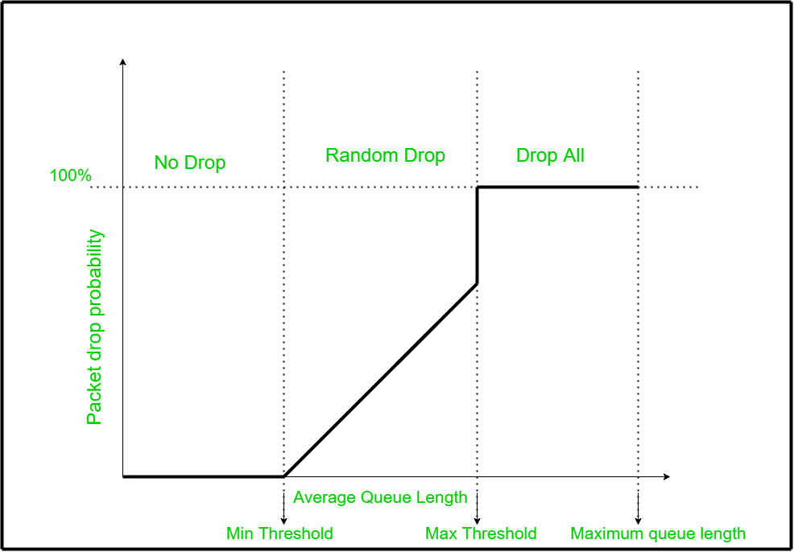
Packet Drop Flow Variation Graph in RED Algorithm:

Slide 14
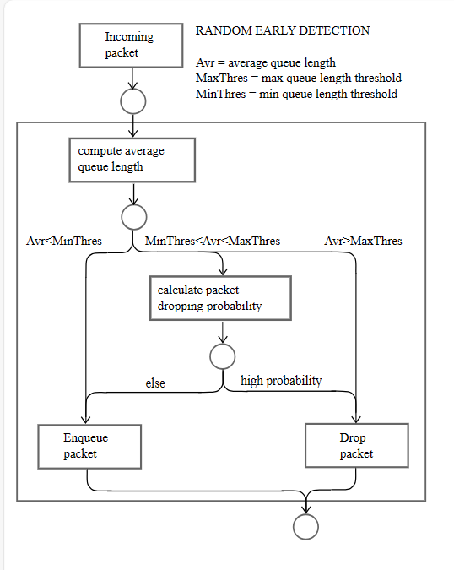
Flow chart on how RED Algorithm Works:

Slide 15
Pseudocode for RED Algorithm:
On arrival of every packet:
Step 1: if (the queue is empty) newavg = (1 – w_{q})^{m} x oldavg.
else newavg = (1 – w_{q}) x oldavg + w_{q} x current_queue_len.
Step 2: if (newavg ≤ minth) enqueue the incoming packet.
else if (newavg > max_{th}).
drop the incoming packet.
else Calculate P_{d} and P_{a.}
Step 3: if (P_{a}≤ R) enqueue the incoming packet.
else drop the incoming packet.
Configurable knobs in RED:
w_{q}
min_{th}
max_{th}
max_{p}
mean packet size

